Slide 1

Blockchains
& Distributed Ledgers
Lecture 06
Aggelos Kiayias
Slide credits: AK, Dimitris Karakostas, Nikos Leonardos

Slide 2
Permissionless Protocols
Bitcoin and similar PoW-based blockchain protocols operate in the permissionless setting:
Anyone can participate in the protocol and receive BTC as rewards by performing the PoW-based mining operation
Parties can come and go as they wish – no permission is required.
Minting new coins (via PoW) makes it feasible for anyone (possessing sufficient hashing power) to participate
The ledger itself is public, readable and writeable by anyone
read (retrieve ledger information): connect to the network and download the ledger
write (insert new information to the ledger): obtain some bitcoins and create a transaction
Sybil resilience:
Relies on computational power: it doesn’t matter how many relays/nodes the adversary controls – what matters is its computational power.

Slide 3
Dynamic Availability
Parties join and leave at will
Need to bootstrap a chain when (re)joining):
Bitcoin’s “longest chain rule” (most difficult chain)
Number of online/offline parties changes over time
Analysis must account for that
No a priori knowledge of participation levels
Unannounced disappearance
Classic BFT protocols do not operate under general dynamic availability
Notes:
One central aspect of Bitcoin whihch is a very nice feature: DA
Seems to be a nice feature of the protocol. Thats what we called before dynamic and easy participation: «join and start.»

Slide 4
Bitcoin’s Energy Problem
Bitcoin resolves dynamic availability via PoW
Parties have limited access to a resource (computational power)
They repeatedly try to solve cryptographic puzzles (hashes)
A puzzle solution allows to create a block and append it to the chain
Bitcoin is energy inefficient
The resource employed is physical (is this protocol the best use of it?)
The hash-based lottery consumes energy to ensure the protocol’s security
An energy arms race between the good guys and the (potential) bad guys
Bitcoin presumes that it is under attack at all times
Notes:
An energy arms race between the good guys and the bad guys

Slide 5
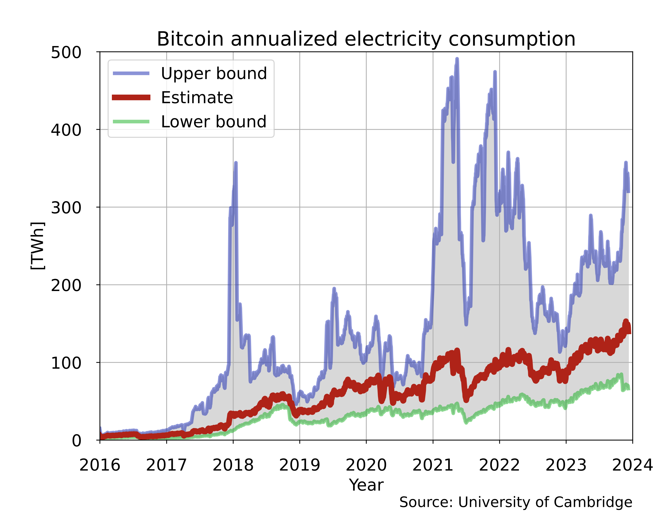
Bitcoin’s Energy Problem - electricity consumption
Many european countries
Are in this range
https://en.wikipedia.org/wiki/Environmental_impact_of_bitcoin
Notes:
An energy arms race between the good guys and the bad guys

Slide 6
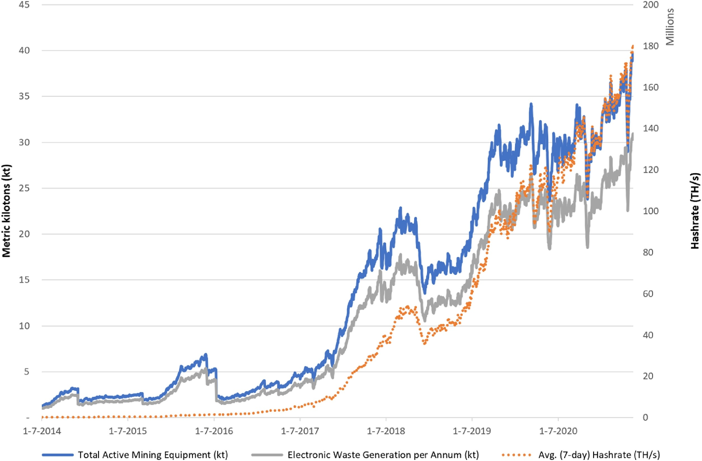
Bitcoin’s Energy Problem - electronic waste
https://en.wikipedia.org/wiki/Environmental_impact_of_bitcoin
Notes:
An energy arms race between the good guys and the bad guys

Slide 7
Bitcoin’s Energy Problem - “digital crude”
Between 2016-2021:
per coin climate damages from BTC were increasing, rather than decreasing as the industry matured
during certain time periods, BTC climate damages exceed the price of each coin created
on average, each $1 in BTC market value created was responsible for $0.35 in global climate damages
between beef production and crude oil burned as gasoline
an order-of-magnitude higher than wind and solar power
Benjamin A. Jones, Andrew L. Goodkind & Robert P. Berrens.
Economic estimation of Bitcoin mining’s climate damages demonstrates closer resemblance to digital crude than digital gold (2022)
Notes:
An energy arms race between the good guys and the bad guys

Slide 8
Proof-of-Stake (PoS)

Slide 9
The time slot
Time is continuous
Protocol breaks time in slots
Defines a “slot length” parameter (in seconds)
Slot large enough
E.g., if network is assumed synchronous, slot length depends on graph’s diameter, s.t. all parties receive a message within a time slot
Slot not too large
Otherwise protocol is slow
E.g., in Bitcoin waiting until tx is published is 10 mins (until a block is created) or more (for safety, k blocks are needed)
Parties act based on the time slot they are in
Requires synchronized clock

Slide 10
Proof-of-Stake (PoS)
Sybil resilience depends on “stake”
Stake: the amount of digital assets (tokens) a party controls
Akin to computational power in PoW, but stake is digital
Energy efficient: no need to consume high amounts of energy to run the stake-based lottery
Parties produce blocks proportionally to the stake they control
Smallest rate: linearly proportional
Assumption: Adversary does not control a stake majority
Corrupted parties control, on aggregate, less stake than the honest parties
Two broad categories:
Nakamoto-style
BFT-style

Slide 11
From PoW to PoS, Nakamoto style
The setting:
The number of all assets is known
Tokens are recorded on the ledger
The public key that controls each asset is known
Stake transfers (e.g., payments) are recorded on the ledger
One block should be created per slot
High level idea:
At each slot, choose one of the assets at random
Relaxation: choose a very small number of assets at random
The owner of the chosen asset is eligible to produce a block at that slot
Owner: the person with the private key that owns the asset

Slide 12
PoS setting
Assume (for now) that stake does not change hands
There are no changes in stake ownership
The initial set of stake owners is known (e.g., hardcoded in the genesis block)
Let n be a node
vk_{n}: the public key of n
stake_{n}: the stake owned by n
Both vk_{n} and stake_{n} are known by all parties

Slide 13
Recall PoW
H(x, s, ctr) < T
H: hash function
ctr: PoW counter
x: MTR of block’s transactions
s: hash of previous block’s header
T: difficulty threshold

Slide 14
From PoW to PoS - Attempt 1
Require: H(x, s, vk_{n}) < T ᐧ stake_{n}
threshold is proportional to stake of each party (right side of inequality)

Slide 15
From PoW to PoS - Attempt 1
Require: H(x, s, vk_{n}) < T ᐧ stake-factor_{n}
threshold is proportional to stake of each party (right side of inequality)
Grinding Attack on x:
Attacker can try different x’s (e.g., transaction MTRs) to find one that satisfies the inequality

Slide 16
From PoW to PoS - Attempt 2
Require: H(s, vk_{n}) < T ᐧ stake-factor_{n}
threshold is proportional to stake of each party (right side of inequality)
inequality’s left side does not depend on input x (to prevent grinding)

Slide 17
From PoW to PoS - Attempt 2
Require: H(s, vk_{n}) < T ᐧ stake-factor_{n}
threshold is proportional to stake of each party (right side of inequality)
inequality’s left side does not depend on MTR (to prevent grinding)
Stalling Hazard:
With some probability (depending on T), no vk will satisfy the equation → No block is created at that slot → No parameter in the inequality changes → The protocol stalls

Slide 18
From PoW to PoS - Attempt 3
Require: H(s, vk_{n}, ts) < T ᐧ stake-factor_{n}
threshold is proportional to stake of each party (right side of inequality)
inequality’s left side does not depend on MTR (to prevent grinding)
ts (e.g., timestamp) changes as slots change (to prevent stalling)

Slide 19
From PoW to PoS - Attempt 3
Require: H(s, vk_{n}, ts) < T ᐧ stake-factor_{n}
threshold is proportional to stake of each party (right side of inequality)
inequality’s left side does not depend on MTR (to prevent grinding)
ts (e.g., timestamp) changes as slots change (to prevent stalling)
Content Malleability:
Block’s content (transactions) not represented in the header anymore → Attacker can alter the previous blocks’ transactions without altering the headers (which are validated in the PoS mechanism)

Slide 20
From PoW to PoS - Attempt 4
Require: H(s, vk_{n}, ts) < T ᐧ stake-factor_{n}
threshold is proportional to stake of each party (right side of inequality)
inequality’s left side does not depend on MTR (to prevent grinding)
ts (e.g., timestamp) changes as slots change (to prevent stalling)
Use the signing key for vk_{n} to sign each payload (to prevent content malleability)

Slide 21
From PoW to PoS - Attempt 4
Require: H(s, vk_{n}, ts) < T ᐧ stake-factor_{n}
threshold is proportional to stake of each party (right side of inequality)
inequality’s left side does not depend on MTR (to prevent grinding)
ts (e.g., timestamp) changes as slots change (to prevent stalling)
Use the signing key for vk_{n} to sign each payload (to prevent content malleability)
Posterior Corruptions:
Attacker can corrupt parties after the slot passes when they create a block → Attacker can change part (or all) of the chain’s history (costless simulation)

Slide 22
From PoW to PoS - Attempt 5
Require: H(s, vk_{n}, ts) < T ᐧ stake-factor_{n}
threshold is proportional to stake of each party (right side of inequality)
inequality’s left side does not depend on MTR (to prevent grinding)
ts (e.g., timestamp) changes as slots change (to prevent stalling)
Use the signing key for vk_{n} to sign each payload (to prevent content malleability)
Key Evolving Signatures (KES) (to prevent posterior corruptions)
Parties refresh their keys comtinuously (delete old keys, create new keys linked with old ones)

Slide 23
From PoW to PoS - Attempt 5
Require: H(s, vk_{n}, ts) < T ᐧ stake-factor_{n}
threshold is proportional to stake of each party (right side of inequality)
inequality’s left side does not depend on MTR (to prevent grinding)
ts (e.g., timestamp) changes as slots change (to prevent stalling)
Use the signing key for vk_{n} to sign each payload (to prevent content malleability)
Key Evolving Signatures (KES) (to prevent posterior corruptions)
Parties refresh their keys comtinuously (delete old keys, create new keys linked with old ones)
Adaptive attack:
vk that satisfies inequality is publicly known before the time slot starts → Attacker can predict the slot “leader schedule” → Can corrupt a party that is known to be leader of a specific future slot

Slide 24
From PoW to PoS - Attempt 6
Require: VRF(sk_{n}, s || ts) < T ᐧ stake-factor_{n}
threshold is proportional to stake of each party (right side of inequality)
inequality’s left side does not depend on MTR (to prevent grinding)
ts (e.g., timestamp) changes as slots change (to prevent stalling)
Use the signing key for vk_{n} to sign each payload (to prevent content malleability)
Key Evolving Signatures (KES) (to prevent posterior corruptions)
Parties refresh their keys comtinuously (delete old keys, create new keys linked with old ones)
Verifiable Random Function (VRF) (to prevent adaptive corruptions)
Intuition: a party runs the inequality using its secret key
The VRF output is verifiable publicly (i.e., with the party’s public key)

Slide 25
Dynamic Stake
Stake changes hands via payments/transfers
New stakeholders (i.e., keys) are added
The stake of old stakeholders is reduced
Stake ownership distribution depends on the chain (i.e., branch)
Different blocks (in different chains) will contain different transactions

Slide 26
Key Grinding Attack
Each user’s key is created locally (by the user)
Creating keys is (effectively) costless
The adversary may be able to play multiple possible VRF calculations “in its head” prior to committing to a particular key.

Slide 27
Key Grinding Attack
Each user’s key is created locally (by the user)
Creating keys is (effectively) costless
The adversary may be able to play multiple possible VRF calculations “in its head” prior to committing to a particular key.
Solutions:
Have all parties commit to their keys
Generate randomness to include into the VRF calculation.
Key point: hashing a prior VRF value sequence may suffice!
Time is divided into epochs: each epoch has its own stakeholder distribution and randomness.

Slide 28
Long-range attack
genesis
honest chain
slot 1
slot 2
slot 3
slot 4
slot 5
Epoch 1

Slide 29

Long-range attack
genesis
honest chain
slot 1
slot 2
slot 3
slot 4
slot 5
Epoch 1

Slide 30
Long-range attack
long-range fork
genesis
honest chain
slot 1
slot 2
slot 3
slot 4
slot 5
slot 6
slot 7
slot 8
slot 9
slot 10
Epoch 1
Epoch 2

Slide 31
Long-range attack
long-range fork
genesis
honest chain
slot 1
slot 2
slot 3
slot 4
slot 5
slot 6
slot 7
slot 8
slot 9
slot 10
slot 11
slot 12
slot 13
slot 14
slot 15
Epoch 1
Epoch 2
Epoch 3

Slide 32
Long-range attack
The attack:
Starting from an old block, the attacker creates a chain of adversarial-only blocks
In this chain, it collects the rewards for every block
In this branch/“fork”, the attacker’s stake is increased
After some point, the attacker gets stake majority in this fork
Because of costless simulation, the attacker can create an arbitrarily long chain in “its head”
The adversary can easily confuse a freshly joining party

Slide 33
Long-range attack
The attack:
Starting from an old block, the attacker creates a chain of adversarial-only blocks
In this chain, it collects the rewards for every block
In this branch/“fork”, the attacker’s stake is increased
After some point, the attacker gets stake majority in this fork
Because of costless simulation, the attacker can create an arbitrarily long chain in “its head”
The adversary can easily confuse a freshly joining party
Solution#1: checkpointing
Joining parties receive trusted checkpoint

Slide 34
Long-range attack
The attack:
Starting from an old block, the attacker creates a chain of adversarial-only blocks
In this chain, it collects the rewards for every block
In this branch/“fork”, the attacker’s stake is increased
After some point, the attacker gets stake majority in this fork
Because of costless simulation, the attacker can create an arbitrarily long chain in “its head”
Solution#1: checkpointing
Solution#2: chain density
Basic idea: immediately after the fork, the honest chain’s blocks are more “dense” compared to the attacker’s (forked) chain
A new node that joins the system, chooses a path at each fork by following the most dense branch
The idea behind Ouroboros Genesis

Slide 35
Long-range attack
long-range fork
genesis
honest chain
slot 1
slot 2
slot 3
slot 4
slot 5
slot 6
slot 7
slot 8
slot 9
slot 10
slot 11
slot 12
slot 13
slot 14
slot 15
Epoch 1
Epoch 2
Epoch 3

Slide 36
Permissioned Ledgers

Slide 37
Permissioned Protocols
Participation is restricted:
Producing transactions and/or blocks can only be performed after being authorized by (some) other nodes
In the simplest case, the set of nodes is static:
the set of participating nodes is fixed and determined at the onset of protocol’s execution

Slide 38
Permissioning How-To
Most straightforward approach:
employ a PKI (Public-Key Infrastructure)
Use digital signatures / authentication protocols
Certificate authorities can authorize other entities
authorization includes a signature from the CA on the entity’s public-key, identity info etc
example: TLS/SSL
Sharing certificate authority information is necessary
All computer systems come with preloaded certificates from certificate authorities - a setup assumption
Certificates need to be revoked in case the corresponding secret keys become exposed or the algorithms used are not safe anymore

Slide 39
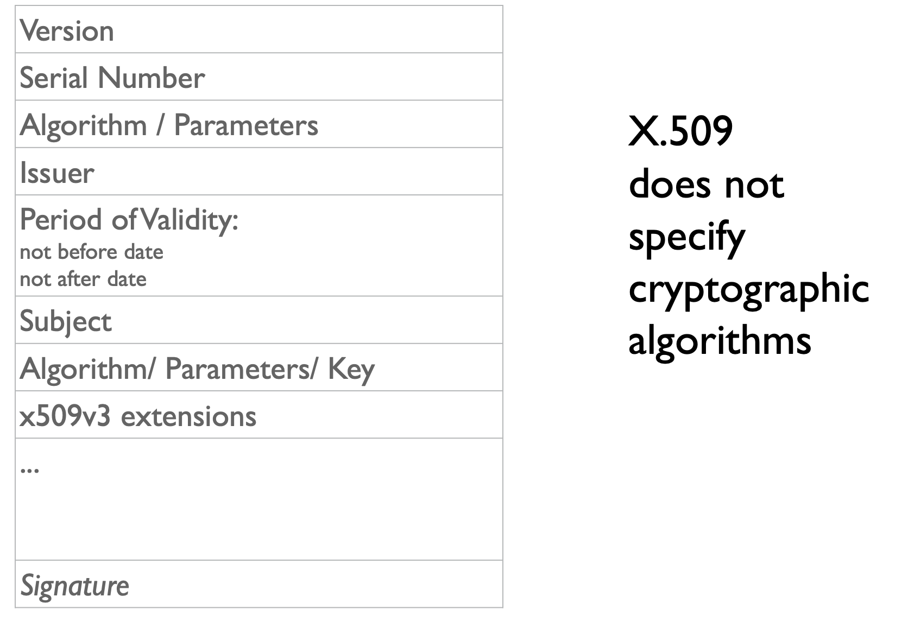
X.509 Certificates
Internet standard since 1988
http://www.ietf.org/rfc/rfc3280.txt
Hierarchical

Slide 40
Digital Signatures and Certificates
A certificate contains a digital signature
Cryptographic design of digital signatures involves typically:
A cryptographic signing operation that acts on a fixed input of a specific type and has a public-verifiability feature
A cryptographic hash function that takes arbitrary strings and maps them to the data type suitable for the signing operation
Common setting today: SHA2 with RSA or DSA

Slide 41
Secure channels and certificates
Possession of mutually acceptable certificates:
permits authenticated communication (exchanging signed mechanism between two entities)
allows building a secure channel
TLS 1.3 can be used to build such secure channel:
Based on cryptographic protocols like Diffie-Hellman key exchange
Data confidentiality ensured

Slide 42
Static Permissioned Ledger
Prior to system’s start:
the nodes register their certificates
these certificates are included in the genesis block
Using these certificates, all nodes are capable of:
authenticating each participant
allowing interaction with the shared state, in a way prescribed by the participants’ credentials
The set of participants remains the same throughout the execution
This is the simplest form of a PKI / public-key directory
[Compare this to PoS protocols]

Slide 43
A Centralised Permissioned Ledger
Assume just a “LOG” of transactions
One of the participants acts as a server and maintains the LOG
Readers and writers to the LOG authenticate with the server and can perform read and write operations
Consistency of the LOG is guaranteed, assuming the server is trusted
Liveness of the LOG is guaranteed, assuming the server is trusted and functional
If server is corrupted, the ledger is compromised
Sometimes referred to as Proof of Authority, PoA

Slide 44
Comparison to Bitcoin’s Permissionless Ledger
The genesis block contains no certificate information
Reading from the LOG is open
anyone can do it, without credentials
Writing to the LOG requires a specific type of credentials
write: insert data into the log
Nodes can obtain valid credentials (accounts) by generating a public and secret-key and:
mine a block (and be rewarded with BTC) or
buy BTC from another node
Once the LOG records their account credit, they can issue transactions (and pay the necessary fees)
In essence: crediting a bitcoin account is akin to creating a certificate that imparts the account holder with certain permissions w.r.t. the ledger

Slide 45
Distributed Permissioned Ledger
A number of servers maintain the ledger (LOG) individually
All share the same genesis block that identifies all participants
Assuming a synchronous operation, at each round, readers and writers:
authenticate with the servers
interact with the LOG in a prescribed fashion

Slide 46
Distributed Permissioned Ledger
A number of servers maintain the ledger (LOG) individually
All share the same genesis block that identifies all participants
Assuming a synchronous operation, at each round, readers and writers:
authenticate with the servers
interact with the LOG in a prescribed fashion
Readers authenticate to each server and obtain read access
Writers authenticate to each server and provide their inputs
Servers run a consensus protocol to agree what inputs should be included in the LOG

Slide 47
Read Requests
Is it possible to restrict read requests, as in the centralized setting?
Hint: Nodes keep blocks of transactions private and issue them only to authenticated users
TLS can be used to build a secure channel between the reader and the responding node
Requirement that all servers remain honest (as they all share the LOG)
Is is possible to impose read restrictions on servers as well?
Hint: Threshold signatures

Slide 48
Reader/Writer Management
Readers and writers can authenticate to each server referring to the information in the genesis block
It is possible to introduce additional readers and writers by suitably issuing certificates to other users
Note that each participant would then need to show a valid certificate chain, that establishes their privileges for the requested read or write access

Slide 49
BFT Protocol Example

Slide 50
“Classical” BFT Consensus (example)
Focus on write requests: we want to ensure LOG liveness and consistency
We will build a “byzantine fault tolerant” (BFT) agreement protocol that uses two important tools:
a graded broadcast
a binary consensus protocol

Slide 51
Graded Consensus
Parties involved :
a single sender
several receivers
The i-th receiver outputs (M_{i}, G_{i})
M_{i}: the output message
G_{i} ∈ {0, 1, 2}: the grade of the message
Properties
If the sender is honest, then M_{i} = M_{j} for all i, j and G_{i} = 2
If the sender is malicious and one receiver outputs (M, 2), then all other honest receivers output (M, G_{i}) with G_{i} ∈ {1, 2}

Slide 52
Graded Broadcast Protocol
Communication
Round 1. The sender sends the message M to all receivers
Round 2. The i-th receiver, who obtained M_{1,i} in round 1, sends it to all receivers
Round 3. The i-th receiver, who obtained M_{2,j,i} from the j-th receiver in round 2:
if there is a single message that was sent by at least 2n/3 receivers, it sends it to all receivers
else does nothing

Slide 53
Graded Broadcast Protocol
Communication rounds
The sender sends the message M to all receivers
The i-th receiver, who obtained M_{1,i} in round 1, sends it to all receivers
The i-th receiver, who obtained M_{2,j,i} from the j-th receiver in round 2:
if there is a single message that was sent by at least 2n/3 receivers, it sends it to all receivers
else does nothing
Output Generation
The honest i-th receiver does the following:
If a single message was received from at least 2n/3 receivers in round 3, output that message as M_{i} and set G_{i} = 2
If a single message was received from at least n/3 receivers in round 3, output that message as M_{i} and set G_{i} = 1
In any other case, output fail as M_{i} and set G_{i} = 0

Slide 54
Graded Broadcast Protocol (Analysis: t < n/3)
Theorem #1
If the sender is honest and broadcasts M, then all honest receivers P_{i} will output G_{i} = 2 and M in the output generation stage.
Proof
If the sender is honest, then all honest receivers will receive the same message M in round 1.
Since t < n/3, each receiver will receive M at least 2n/3 times in rounds 2 and 3 (from the honest parties).
Communication rounds
The sender sends the message M to all receivers
The i-th receiver, who obtained M_{1,i} in round 1, sends it to all receivers
The i-th receiver, who obtained M_{2,j,i} from the j-th receiver in round 2:
if a single message was sent by at least 2n/3 receivers, send it to all receivers
Output Generation
The honest i-th receiver:
If a single message was received from at least 2n/3 receivers in round 3, outputs that message as M_{i} and set G_{i} = 2

Slide 55
Graded Broadcast Protocol (Analysis: t < n/3)
Lemma #1
If two honest receivers send a message in round 3, it must be the same.
Proof
Suppose an honest party P sends message M in round 3:
P has received M by at least 2n/3 parties in round 2 (by definition)
Let h be the number of honest parties that sent M in round 2: h ≥ (2n/3) - t > n/3 (by assumption)
Let p be the parties capable of sending a different message M’ ≠ M in round 2: p = n - h < 2n/3 (by step 2, i.e., since h honest parties sent M)
Therefore, any other honest party in round 3 will send M or do nothing
Communication rounds
The sender sends the message M to all receivers
The i-th receiver, who obtained M_{1,i} in round 1, sends it to all receivers
The i-th receiver, who obtained M_{2,j,i} from the j-th receiver in round 2:
if there is a single message that was sent by at least 2n/3 receivers, it sends it to all receivers
else does nothing

Slide 56
Graded Broadcast Protocol (Analysis: t < n/3)
Theorem #2
Suppose the i-th receiver returns G_{i} = 2 and a message M_{i}; for the j-th honest receiver’s output (M_{j}, G_{j}), it holds M_{i} = M_{j}, G_{j} ∈ {1, 2}.
Proof
First, we show that it cannot be that M_{j} = fail:
The i-th party received M_{i} from at least 2n/3 receivers in round 3 (of which at most t<n/3 adversarial)
So, more than n/3 honest parties sent M_{i} in round 3
Now, suppose M_{j} ≠ M_{i}:
M_{j} was sent by at least n/3 receivers in round 3 (by definition)
At least one of them is honest (since t < n/3)
By Lemma #1, it holds M_{i} = M_{j} [contradiction]
Communication
Round 3. The i-th receiver, who obtained M_{2,j,i} from the j-th receiver in round 2:
if a single message was sent by at least 2n/3 receivers, send it to all receivers
Output Generation
The honest i-th receiver:
If a single message was received from at least 2n/3 receivers in round 3, outputs that message as M_{i} and set G_{i} = 2
If a single message was received from at least n/3 receivers in round 3, output that message as M_{i} and set G_{i} = 1
In any other case, output fail as M_{i} and set G_{i} = 0

Slide 57
From Graded Broadcast to a BFT-Ledger
If grade G_{i} = 2, party P_{i} knows that other honest parties have received M_{i}
Graded broadcast is not enough:
If grade G_{i} = 1, party P_{i} cannot know if other honest parties received the message
Solution:
Perform binary consensus to detect whether everyone has grade 2 or not.

Slide 58
From Graded Broadcast to a BFT-Ledger
A simple approach:
execute n/3 phases (to guarantee at least one honest sender encountered)
in each phase:
A designated sender organizes all valid transactions as M and performs a graded broadcast
A binary consensus protocol determines whether everyone’s grade is 2 or not:
If true, each node signs the output to generate a public endorsement and appends M to their LOG (together with the signatures)
otherwise, LOG remains the same

Slide 59
Byzantine Binary Consensus
(RECALL) n parties, t adversarial
v_{i} ∈ {0, 1} the input of party i
Honest parties should decide on values u_{i} ∈ {0, 1} satisfying the following properties:
Termination: values u_{i} are well defined for all honest parties
Agreement: if parties i and j are honest, then u_{i} = u_{j}
Validity: if, for every honest party i, there exists v ∈ {0, 1} such that v_{i} = v, then each honest party i outputs u_{i} = v
Note: We examine the synchronous setting

Slide 60
Exponential Information Gathering Algorithm (EIG)
Algorithm Sketch:
At round 1, send everyone your input
At round r+1, send everyone all messages you received at round r (avoiding redundant messages – see below)
Each party arranges the messages in its own EIG tree:
Let u₁,...,u_{n} be the messages received in the first round (including own message)
u_{i1i2…ik} is a value 𝑣 s.t. (i_{k} told i) that (i_{k-1} told i_{k}) that … that (i₁ told i₂) that i₁’s initial value was 𝑣
u₁
u₂
u₃
u₄
u₂₁
u₂₃
u₂₄
u₂₃: The value party 3 told me that party 2 sent them in the previous round.
(Food for thought) What is the size of the tree?

Slide 61
EIG Termination
The EIG algorithm terminates after t+1 rounds. The output value of each party is defined as follows:
For each leaf v in the EIG tree, set z_{v}=u_{v}
For an internal node v, set z_{v} equal to the majority of the z-values of its children; if the majority is not defined, set z_{v}=0 (without loss of generality)
Define the output as z_{root}
(Food for thought) Prove that EIG satisfies: i) agreement; ii) validity. (Hint)

Slide 62
Impossibility results - asynchronous setting
Theorem [LSP1982]: Impossible for n < 3t + 1.
Theorem [FL1982]: Impossible in t rounds.
Example: The EIG algorithm with t = 1 needs at least 2 rounds:
If a party received a single 1, its output should be 0. (Because the 1 could be coming from the adversary.)
If a party received two 1s, its output should be 0. (Because one of them could have been sent from the adversary, while another party could have received a single 1 and will decide 0 according to the previous statement.)
And so on… (by induction, the output will always be 0, contradicting validity)
Theorem[GM1998]: Doable for n > 3t in t + 1 rounds.
Theorem [DS83]: Doable for n > 2t assuming a PKI.

Slide 63
Impossibility results - asynchronous setting
Theorem [BT1985]: Asynchronous Byzantine Consensus is impossible with n < 3t + 1, even if the parties have agreed on a PKI (setup).
Partition parties into sets A, B, C of size at most t and consider 3 scenarios:
A malicious, B and C honest with inputs 0. The adversary sends no messages. The honest parties should decide on 0 until some time T_{A}.
B malicious, A and C honest with inputs 1. The adversary sends no messages. The honest parties should decide on 1 until some time T_{B}.
C malicious, B and A honest with inputs 0 and 1 respectively. The adversary communicates with B as the honest C in scenario A and with A as the honest C in scenario B. At the same time every communication between A and B is delayed for time at least max{T_{A}, T_{B}}.
The crux is that A has the same view in scenarios B and C. Similarly for B, in scenarios A and C. Agreement in scenario C is impossible, if validity is achieved in scenarios A and B.

Slide 64
Back to PoS
… using ideas from BFT protocols

Slide 65
BFT-style PoS
High level idea:
At each slot, subselect a committee of stakeholders
Getting elected to the committee is proportional to the party’s owned stake
The committee runs a BFT protocol to agree on the new block
Each block is finalized per the BFT protocol rules
The idea behind Algorand

Slide 66
BFT-style PoS
High level idea:
At each slot, subselect a committee of stakeholders
Getting elected to the committee is proportional to the party’s owned stake
The committee runs a BFT protocol to agree on the new block
Each block is finalized per the BFT protocol rules
The idea behind Algorand
Some security considerations:
Where does the randomness come from (for the committee selection)?
How to prevent grinding attacks?
How to prevent adaptive corruptions?
How to prevent long-range attacks?

Slide 67
Food for thought in Ledger protocols
How to ensure that parties have a synchronised clock?
How do parties coordinate in terms of the time progress?
How do parties agree on which time slot is active at any point in time?
Reference: Ouroboros Chronos (PoS-based), Permissionless Clock Synchronization (PoW-based)
Will rational parties delete their keys?
Key erasures (in KES) are necessary to prevent posterior attacks.
Do parties get any benefit by not deleting their keys? Can an attacker incentivize this?
Can the protocol provide incentives (or counter incentives) to promote key erasure?
“economic security”
What happens if an attacker gets a majority during one epoch?
Can the system recover from temporary adversarial majority?
Can PoW systems recover (without ”social consensus”)? What about PoS?
Reference: Self-healing blockchains

